Slide 1

Automatic Water pump Switch ‘ON’ and ‘OFF’
JAWAHAR EDUCATION SOCEITY ANNASAHEB CHUDAMAN PATIL COLLEGE OF ENGINEERING, NAVI MUMBAI
2021-2022
Guide Name:-Prof. Sangita Nandurkar
Presented By:- Mohd Arif (43)
Nagesh Dasari(45)
Rahul Patil(52)
Aniket Renjarla(58)

Slide 2
Content
Introduction
Block diagram
Circuit diagram
Working
Hardware Photos
Pros and Cons
Application
Conclusion
Future Scope

Slide 3
Selection of topic
It’s very often that, we forgot to switch ON/OFF the motor in proper time that’s why we often fall in embracing situation due to scarcity of water.
It has the ability to overcome those shortages.

Slide 4
Abstract
Water is the important natural resources that should be used more efficiently. In manual system, users are supposed to visit their water tank to check the water level.
The uncontrolled use of water leads to wastage of water and it causes water scarcity. Water automation is a process which is an automatic system to use water. The basic idea of water automation is to ensure the proper use of water and reduce the human effort.

Slide 5
Introduction
Here’s a automatic water pump circuit that controls the water pump motor.
People gradually turn on the pump,forget to turn it off.
Similarly, it gets switched off when the tank is filled up. The circuit is simple, compact and economical. It works off a 12V DC power supply and consumes very little power.

Slide 6
Aim:-The main aim of this work is to build a controlling circuit that controls the water pump motor. Objective:-
1.) To design an automatic water monitoring system
2.)To incorporate an interactive medium between the end user and the machine
3.)To prevent over labor of the pumping machine and prevent it from getting bad
4.)To avoid wastage of water
5.)Since the demand of electricity is very high, automatic water level control saves energy

Slide 7
What is Automatic Water pump
An automatic water pump is an intelligent and economical system designed for water pressure management.
It helps prevent delays, minimise vibrations, and allow for precise and accurate control of your water supply. With such a variety of functions, one of the stand-out benefits is that it’s a highly efficient piece of equipment.

Slide 8
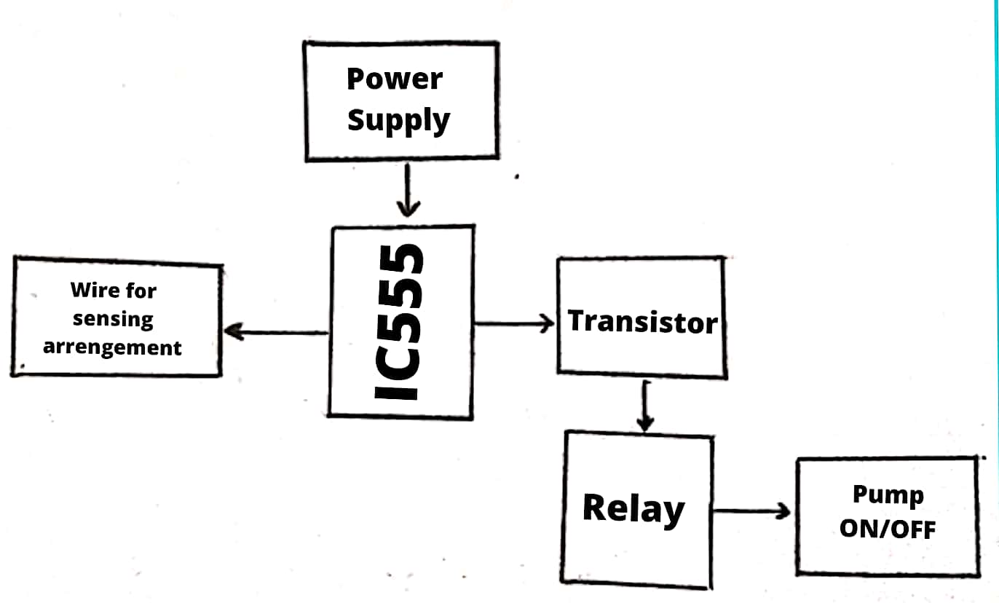
Block Diagram
Figure no 1

Slide 9
Block diagram description
It consist of BC547 Transistor,555 timer,Relay,IN4007,
Diode,Motor& Tank which can fill the water tank.
When the input 12v is given from Battery/Power supply to start working.
The input is given from power supply then the transistor will active through the relay the power is supplied to Ic 555 timer.
The output pin of Ic 555 timer is connected to the relay & diode.
Then the relay is maintained at required level & the motor will start up by switching ON.
Whether motor is ON its ready to fill the tank by recognizing the water level in the tank.
It is depend on the water level.
When the water is full then automatically it get switched off.

Slide 10
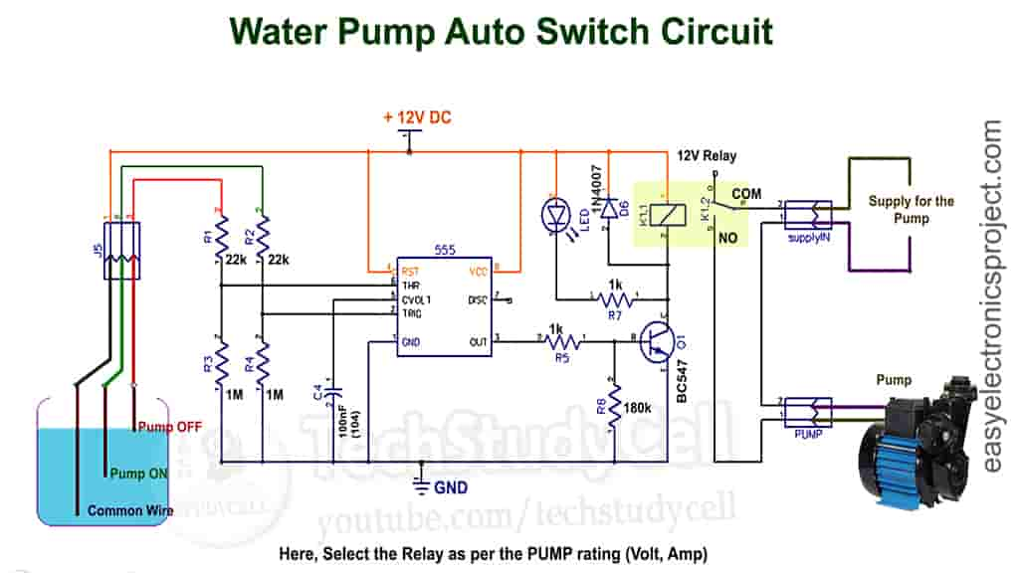
Circuit Diagram

Slide 11
Working
We know the property of 555 timer IC,i.e its output goes high when voltage at the second pin(trigger pin) is less than1/3Vcc
Also we can reset back the IC by applying a low voltage at 4th pin (Reset pin).
In the above circuit 3 wire are dipped in water tank.Let us define two water levels-bottom(Low) &Top(Up)level one of the wire or probe is common wire.
the Probe from bottom level is connected to the trigger (2nd) pin of 555 IC.So the voltage at 2nd pin is Vcc when it is covered by water.
When water level goes down,the 2nd gets disconnected (untouched) from water i.e voltage at the trigger pin become less than Vcc.Then the output of IC555 becomes high.
While the water level rises,the top level probe is covered by water and the transistor becomes ON.

Slide 12
The low voltage at the 4th pin reset the IC555.so the output becomes zero voltage hence the motor will turn OFF automatically.
For simple demonstration of the project we can use a DC motor directly at the output of IC 555 instead of relay.

Slide 13
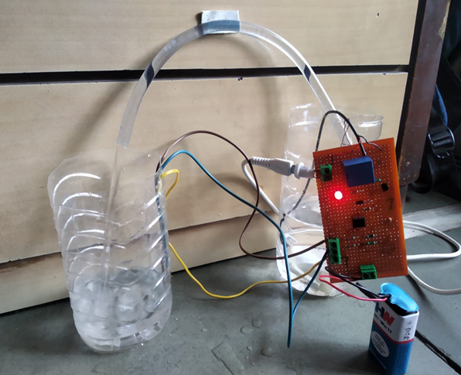
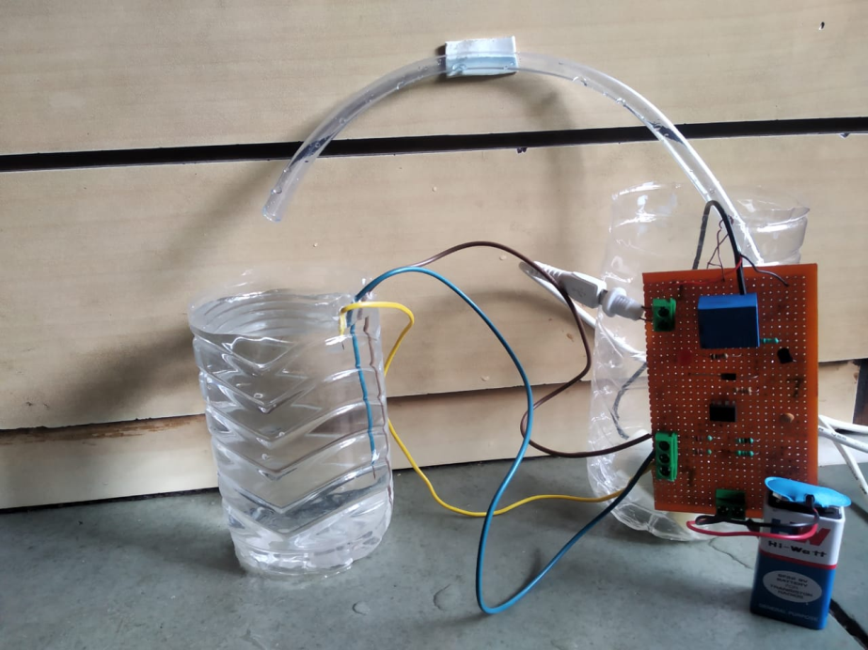
Hardware Photos
Step 1
Step 2
When water is below Common Terminal the pump gets ‘ON’
The pump gets OFF when Water gets full in the Tank or Container

Slide 14
Pros and Cons
Pros | Cons
Automatically stops the water pump from running dry and overheating when the water supply is running out. | Automation can have its disadvantages, as an automated device isn’t typically prepared for every possible scenario
Makes your plumbing or irrigation system more efficient, meaning you’ll save water and possibly electricity as well | As it is an electronic device, the circuitry required a proper and secure cover, and the device can be damaged if water gets inside
When shut down, the auto-restart feature periodically checks if there is water supply, so you don’t have to turn it on again manually | May be challenging to install in some old houses or existing older-style plumbing networks

Slide 15
Application
Corrosion Free.
No current / voltage is passed through water, therefore no electrolysis.
Long life.
Save of electricity due to perfect timing of water pump operation.
Ease of use.

Slide 16
Conclusion
The main advantage of this automatic water pump is that it automatically controls the pump without any interaction.
The automatic pump eliminate the need for any manual switching of pumps installed for the purpose of pumping water from a reservoir to an overhead tank.

Slide 17
Future Scoope
The project was design to automatically control the pump which ensures constant reserve of water in the reservoir. The scope of the design was keep concise and simple to in other not to introduce unnecessary complexities and render it generally uncomfortable.
The system does not have attached complex peripheral device which though impossible for the detail printable information has been excluded for reasons of affordability material of low range and less accurate performances as opposed to a well built automatic water pump was use d to achieve this aim, the automatic water level controller detect and control the water in the tank.

